Slide 1

Unit 7: Movies
Lesson 3.1: Reading and Writing
Page 61

Slide 2

WARM UP

Slide 3
Put these words in the correct column
soldiers king general battle army invaders
Words stressed on the first syllable | Words stressed on the second syllable
soldier
invader
king
general
battle
army

Slide 4
What do you remember from the last lesson? Which word is that?
S
A
Army
Soldier
I
K
Invaders
King
B
G
Battle
General

Slide 5
Who do you think of?
a famous Vietnamese King
Quang Trung
born in 1753
Người Anh Hùng Áo Vải
Ngọc Hồi – Đống Đa-1789
What else do you know about him?
-When did he become King?
-Did he use horse?

Slide 6
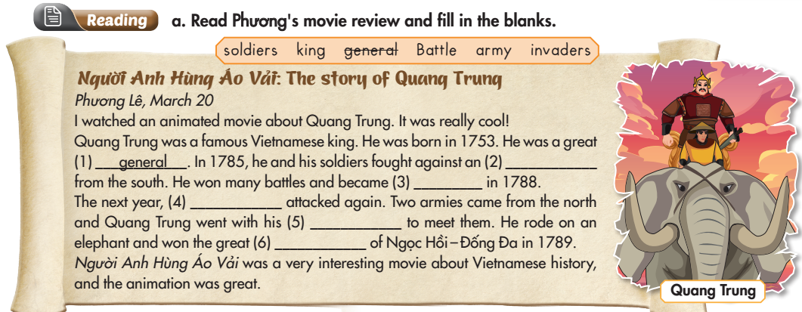
While-Reading
army
King
invaders
soldiers
Battle
Notes:
T can suggest S to watch the movie on youtube.

Slide 7
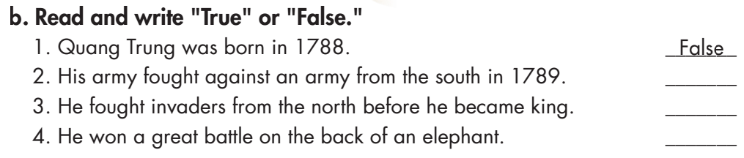
While-Reading
Underline the key words

Slide 8
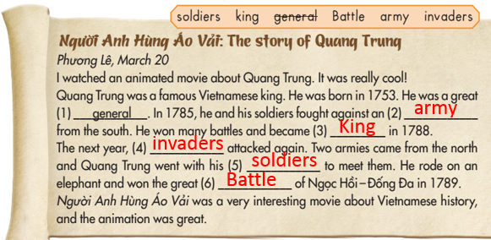
False

Slide 9
False
True

Slide 10

Work in pairs. Practice the conversation
A: What is the name of the movie?
B: It’s Anh Hùng Áo Vải.
A: What is the movie about?
B: It’s about Quang Trung.
A: When was he born?
B: He was born in 1753
A:When did he become King?
B:He became King in 1788.
A: What is he famous for?
B: He is famous for the great battle of Ngọc Hồi-Đống Đa in 1789.

Slide 11
Use this conversation to ask and answer about movie
A: What is the name of the movie?
B: It’s _________.
A: What is the movie about?
B: It’s about ________.
A: When was he/she born?
B: He/She was born ________.
A:When did he/she become King/Queen?
B:He/She became King/Queen in _________.
A: What is he/she famous for?
B: He/She is famous for ____________.

Slide 12
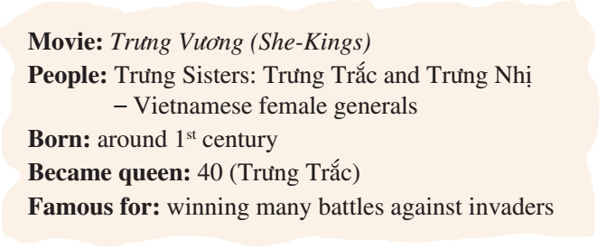
You answer your friend B question about Movie Trưng Vương. And ask for information about the movie you friend watched. Fill in the table
Student A:
Movie:
Person:
Born:
Became King:
Famous for:

Slide 13
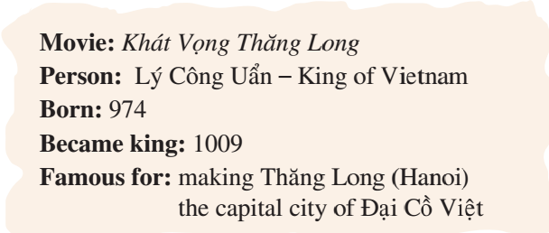
Student B:
You answer your friend A question about Movie Khát Vọng Thăng Long. And ask for information about the movie you friend watched. Fill in the table.
Movie:
People:
Born:
Became King/Queen:
Famous for:

Slide 14

Writing

Slide 15
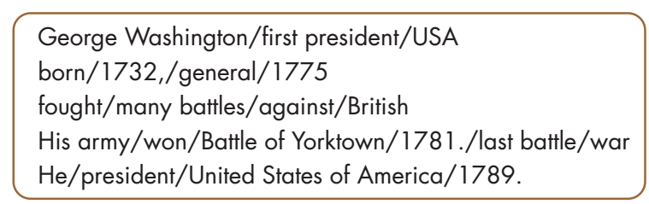
While-Writing
a. With a partner, use the notes to make sentences about the famous American, George Washington.

Slide 16
a. With a partner, use the notes to make sentences about the famous American, George Washington.
George Washington/first president/USA
George Washington was the first president of the USA.
born/1732,/general/1775
He was born in 1732 and became a general in 1775.
fought/many battles/against/British
He fought many battles against the British.
His army/won/Battle of Yorktown//1781./last battle/war
His army won the Battle of Yorktown in 1781. It was the last
battle of the war.
He/president/United States of America/1789.
He became president of the United States of America in 1789.

Slide 17
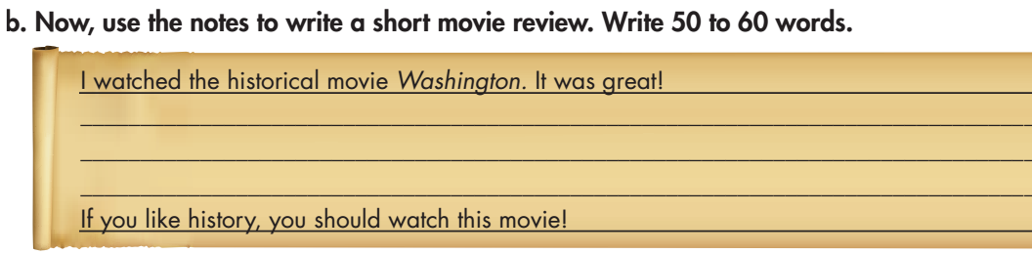
While-Writing

Slide 18
While-Writing
I watched the historical movie Washington. It was great! It was about George Washington. He was the first president of the USA. He was born in 1732 and he became a general in 1775. He fought many battles against the British. His army won the Battle of Yorktown in 1781. It was the last battle of the war. He became president of the United States of America in 1789. If you like history, you should watch this movie!

Slide 19
Post-Writing
Choose a Movie about a famous person from history and write a movie review
I watched the historical movie _______. It was great! It was about _______. He/She was the _______ . He/She was born _______and he became a _______ in _______. He/She fought many battles against _______ in______. If you like history, you should watch this movie!

Slide 20

CONSOLIDATION

Slide 21
Lesson 3
Homework
Do the exercises on page 43 WB
Complete the writing notes in Tiếng Anh 6 i-Learn Smart World Notebook on page 44
Prepare the review lesson (pages 98-99 SB)
Play the consolidation games in Tiếng Anh 6 i-Learn Smart World DHA App on www.eduhome.com.vn

Slide 22
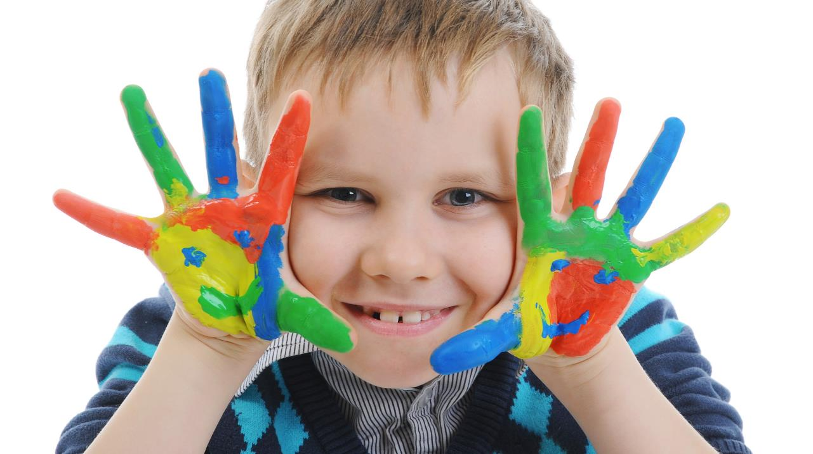
Enjoy your day!

